Slide 1
ParaBank
End-to-End Automation Framework
Selenium
Java
TestNG
Maven
Presented by: Nagulagama Karthik
Role: SDET – Automation Project
Notes:
Welcome. Today I'll walk you through the ParaBank End-to-End Automation Framework built with Selenium, Java, TestNG, and Maven.

Slide 2
Agenda
01 Project Overview
06 Utilities & Config
02 Objectives
07 Test Cases
03 Technology Stack
08 Execution Flow
04 Framework Architecture
09 Test Results
05 Page Object Model
10 Conclusion
Notes:
Today's agenda covers 10 main topics from project overview through conclusion.

Slide 3
Project Overview
Application Under Test 🏦
Design Pattern 🏗️
Reusable Framework ⚙️
ParaBank is a feature-rich web-based banking application — the perfect real-world target for end-to-end automation covering login, registration, transfers, and bill payments.
Implemented the Page Object Model (POM) design pattern to cleanly separate UI locators from test logic. Every screen has its own dedicated Java class.
Built a scalable, maintainable automation framework with shared utilities, base classes, centralized configuration, and screenshot capture evidence.
Notes:
ParaBank is our automation target. We applied POM and built a reusable framework.

Slide 4
Problem Statement – Why Automate?
⏱️
Time Consuming
🔁
Repetitive Tasks
Manual test execution for each release cycle takes days, delaying delivery and blocking fast feedback.
Testers repeatedly run identical regression scenarios, causing fatigue and reducing focus on exploratory testing.
❗
Human Errors
📉
Difficult Regression
Manual testing is prone to missed steps, inconsistent data entry, and oversight — especially under deadline pressure.
As the app grows, full regression coverage becomes impossible to maintain manually within sprint timelines.
Notes:
Manual testing creates bottlenecks in four areas — time, repetition, errors, and regression coverage.

Slide 5

Project Objectives
What this framework is designed to achieve
Reduce Manual Effort
Automate repetitive regression scenarios, freeing testers for exploratory and edge-case testing
Increase Test Coverage
Cover all critical banking flows — registration, login, fund transfer, and bill payment
Build a Reusable Framework
Modular POM-based code means changes to one page class do not ripple across tests
Achieve Faster Execution
Run the full test suite in ~38 seconds rather than hours of manual effort per cycle
Easy Maintenance
Centralized locators and config mean UI changes require minimal code updates
Notes:
Five objectives drive this project: less manual effort, more coverage, reusability, speed, and maintainability.

Slide 6
Tools & Technologies
Java
Selenium WebDriver
TestNG
Core programming language for all test scripts and framework utility classes
Browser automation library that drives Chrome to interact with the ParaBank UI
Test execution framework providing annotations, sequencing, and reporting capabilities
Maven
Eclipse IDE
ChromeDriver
Build and dependency management tool — controls all library versions via pom.xml
Integrated development environment for writing, debugging, and running automation code
WebDriver implementation that bridges Selenium with the Google Chrome browser
Notes:
Our stack: Java, Selenium WebDriver, TestNG, Maven, Eclipse IDE, and ChromeDriver.

Slide 7
Why Selenium WebDriver?
Key Advantages
Selenium
🆓
Open Source & Free
is the world's #1
browser automation
framework
No licensing cost — ideal for teams of any size
🌐
Multi-Browser Support
Works with Chrome, Firefox, Edge, Safari out of the box
☕
Java Integration
Trusted by Google,
Microsoft & Amazon
Native support for Java with clean, well-documented APIs
🔗
TestNG Integration
Seamlessly pairs with TestNG for structured test execution
✓ Active Community
✓ Rich Documentation
✓ CI/CD Ready
🏢
Industry Standard
Used by Google, Amazon, Microsoft — great career skill
Notes:
Selenium is the industry standard — free, multi-browser, Java-compatible, and integrates with TestNG.

Slide 8
Framework Architecture
TestNG
Test runner & annotations
▼
Test Cases
RegisterTest · TransferFundsTest · BillPayTest · DemoTest
▼
Page Classes (POM)
LoginPage · RegisterPage · TransferFundsPage · BillPayPage
▼
Utilities
BaseTest · ConfigReader · ScreenshotUtil · TestData
▼
WebDriver
ChromeDriver browser control layer
▼
Browser (Chrome)
ParaBank web application target
Notes:
The framework flows from TestNG at the top, through test cases, page classes, utilities, WebDriver, down to Chrome.

Slide 9
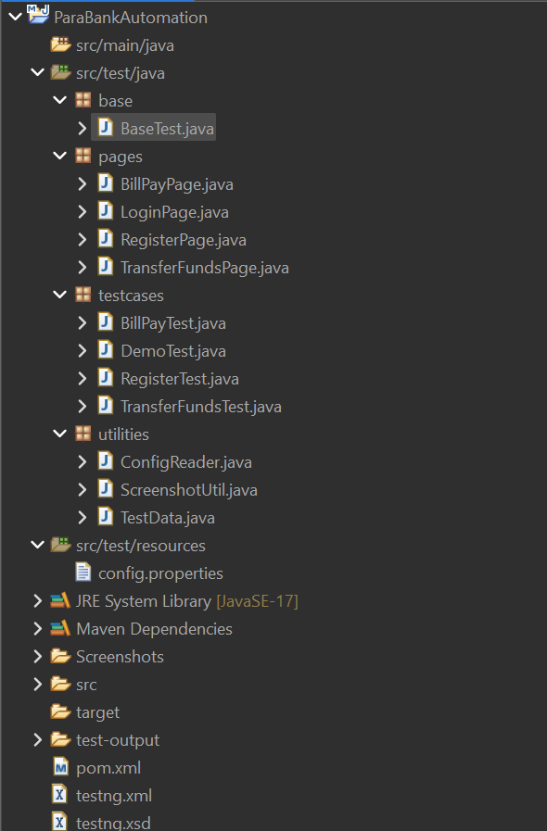
Maven Project Structure
Key Files
pom.xml
Manages Selenium, TestNG, Maven plugin dependencies
testng.xml
Defines suite, test classes, and execution order
config.properties
Stores URL, username, password for easy switching
src/main/java
Framework utility code shared across all test cases
src/test/java
All page objects and test scripts live here
Notes:
Maven standardizes the project layout. pom.xml and testng.xml are the heart of the configuration.

Slide 10
Folder Structure – src/test/java
📁 base/
Contains BaseTest.java — browser setup (@BeforeMethod) and teardown (@AfterMethod)
📁 pages/
Page Object classes for each screen: LoginPage, RegisterPage, TransferFundsPage, BillPayPage
📁 utilities/
Helper classes: ConfigReader, ScreenshotUtil, and TestData for shared test state
📁 testcases/
Actual test scripts: RegisterTest, TransferFundsTest, BillPayTest, DemoTest
📁 Screenshots/
Auto-generated folder where ScreenshotUtil saves PNG evidence on test pass/fail
Notes:
Five packages: base, pages, utilities, testcases, and Screenshots folder for test evidence.

Slide 11
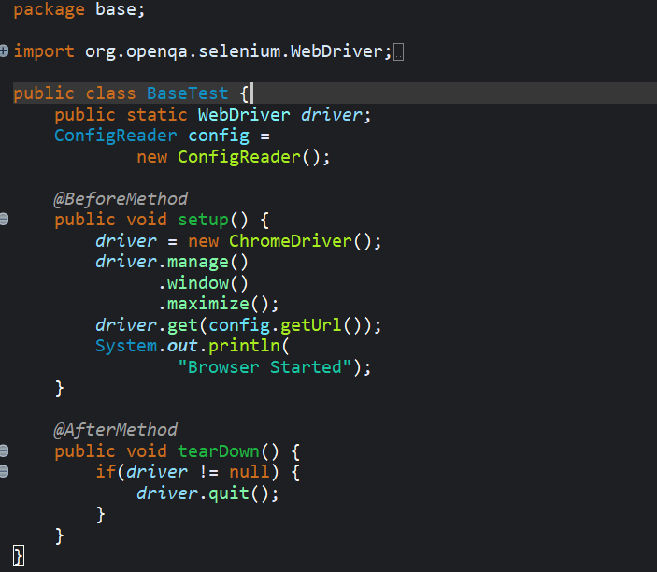
BaseTest.java – Browser Lifecycle Management
@BeforeMethod
Runs before every test — sets up a fresh ChromeDriver instance and opens the app URL
ChromeDriver Setup
Initialises ChromeDriver, maximises window, and navigates to URL from config.properties
@AfterMethod
Runs after every test — closes the browser to release resources and prevent memory leaks
Notes:
BaseTest manages browser lifecycle. Every test class extends BaseTest to inherit setup and teardown.

Slide 12

ConfigReader.java – Centralised Configuration
config.properties
ConfigReader.java
Properties prop = new Properties();
▶
prop.load(new FileReader(
"config.properties"));
getURL() → prop.get("url")
getUser() → prop.get("username")
getPass() → prop.get("password")
Single Source of Truth
No Hardcoding
Environment Switching
Change URL or credentials in one file — all tests pick it up automatically
Credentials and URLs are never embedded in test code
Switch between dev, staging, and production by editing one file
Notes:
ConfigReader loads URL, username, and password from config.properties — no hardcoding, easy environment switching.

Slide 13
Page Object Model (POM)
The design pattern that keeps tests clean and maintainable
❌ Without POM
✅ With POM
✗ Locators scattered across all test files
✓ Each page has its own dedicated class
✗ Same element located in 10 different tests
✓ Tests call reusable methods from page classes
✗ One UI change → update dozens of files
✓ UI change → update only one page class
✗ Tests tightly coupled to implementation
✓ Clean separation of logic and page actions
✗ Very hard to debug at scale
✓ Easily scales as the application grows
Notes:
POM separates page locators from test logic. One class per screen makes code reusable and easy to maintain.

Slide 14
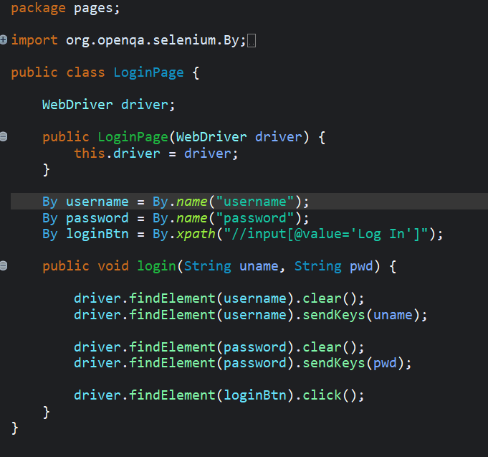
LoginPage.java – Page Object Class
Constructor
Receives the WebDriver from the test so it operates on the same browser session
Locators (By)
Element locators stored as class fields — username/password fields and login button
login() Method
Reusable action method — enters user/pass and clicks login. Any test calls this in one line
Notes:
LoginPage encapsulates all login UI interactions. Tests call login() in one line without knowing locator details.

Slide 15
RegisterPage.java – User Registration
1
Navigate to Register
Clicks the 'Register' link on the home page to open the registration form
2
Fill Personal Details
Enters first name, last name, address, city, state, zip, phone, and SSN into form fields
3
Generate Unique Username
Appends System.currentTimeMillis() to a base string — ensures uniqueness on every test run
4
Set Password
Enters and confirms the password for the new account
5
Submit & Store
Clicks 'Register' then saves the generated username in TestData.java for later tests
Notes:
RegisterPage fills the form step by step, generates a unique username using timestamps, and stores it in TestData.

Slide 16
TransferFundsPage.java – Fund Transfer
🔐
🏠
💸
🔢
✅
📋
→
→
→
→
→
Login
Home Page
Transfer Funds
Enter Amount
Submit
Verify
Use registered credentials
Post-login landing page
Navigate to Transfer page
Input transfer value
Click Transfer button
Assert success message
Key Code – TransferFundsPage.java
driver.findElement(By.linkText("Transfer Funds")).click();
driver.findElement(By.id("amount")).sendKeys("500");
driver.findElement(By.id("transferButton")).click();
String msg = driver.findElement(By.tagName("h1")).getText();
Assert.assertEquals(msg, "Transfer Complete!");
Notes:
TransferFundsPage navigates to transfer section, enters amount, submits, and asserts the success message.

Slide 17
BillPayPage.java – Bill Payment
Payee Name
Electricity Board
Address
Hyderabad
Name of the bill recipient
Payee's street address
City
Hyderabad
State
Telangana
City of the payee
State abbreviation
Zip Code
500001
Phone
9876543210
5-digit postal code
Contact number of payee
Account #
12345
Amount
$500
Destination account number
Payment amount to transfer
→ Click 'Send Payment' → Assert: Bill Payment Complete!
Notes:
BillPayPage fills in payee details, enters payment amount, submits, and verifies success confirmation.

Slide 18
Utility Classes
TestData.java
ScreenshotUtil.java
ConfigReader.java
Shared Test State
Evidence Capture
Configuration Management
Holds the dynamically generated username as a public static variable, allowing RegisterTest to store it and subsequent tests (TransferFunds, BillPay) to retrieve it without re-registering.
Captures a screenshot at the end of each test using Selenium's TakesScreenshot interface. Saves the PNG to the Screenshots/ folder with a timestamped filename for traceability.
Reads URL, username, and password from config.properties using Java's Properties class. Returns values via static methods callable from anywhere in the framework.
public static String username;
captureScreenshot(driver, name)
getURL() · getUser() · getPass()
Notes:
Three utilities: TestData shares state, ScreenshotUtil captures evidence, ConfigReader manages configuration.

Slide 19
Test Cases
RegisterTest
TransferFundsTest
1. Open registration page
1. Login with registered user
2. Fill form with valid data
2. Navigate to Transfer Funds
3. Generate unique username
3. Enter $500 amount
4. Submit registration
4. Select accounts
5. Assert: Registration Successful
5. Assert: Transfer Complete!
BillPayTest
DemoTest
1. Login with registered user
1. End-to-end smoke test
2. Navigate to Bill Pay
2. Validates overall flow
3. Fill all payee details
3. Uses all page objects
4. Enter payment amount
4. Confirms integration
5. Assert: Bill Payment Complete
5. Assert: Full flow passes
Notes:
Four test classes: RegisterTest, TransferFundsTest, BillPayTest, DemoTest — covering the full banking workflow.

Slide 20
Test Execution Flow
📄 testng.xml
Suite entry point — defines class order
▼
📝 RegisterTest
Creates account & saves username to TestData
▼
💸 TransferFundsTest
Logs in, reads username from TestData, transfers $500
▼
🧾 BillPayTest
Logs in, pays bill using shared username
▼
🔁 DemoTest
End-to-end validation across all features
Notes:
testng.xml controls order. RegisterTest runs first; later tests share the username via TestData.java.

Slide 21
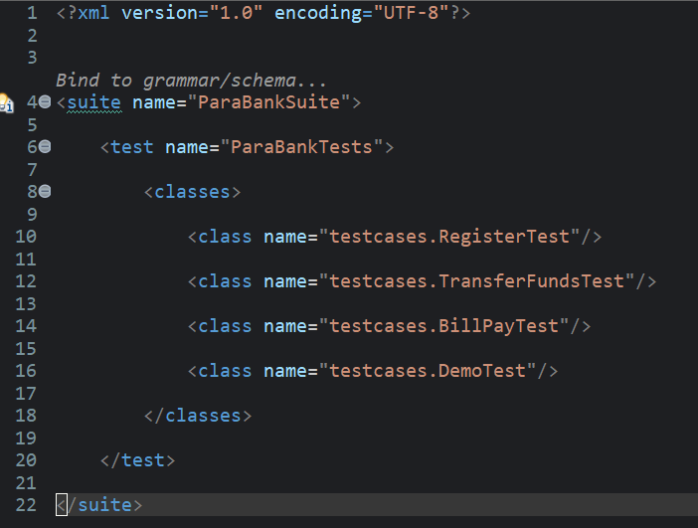
testng.xml – Test Suite Configuration
suite tag
Defines the entire test suite. verbose=1 enables console logging during execution.
test tag
Groups a collection of test classes into one logical test batch.
classes section
Lists each test class by fully-qualified name. TestNG executes them in listed order.
Execution Order
Register → TransferFunds → BillPay → Demo. Order matters — later tests need the registered username.
Notes:
testng.xml is the master control file defining suite name, test name, and class execution order.

Slide 22
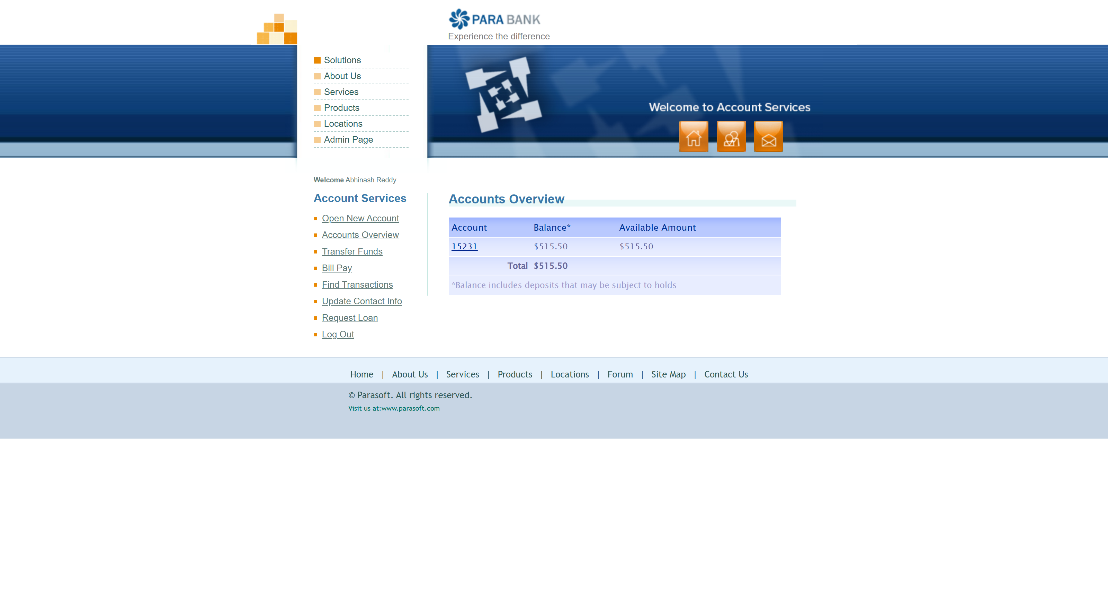
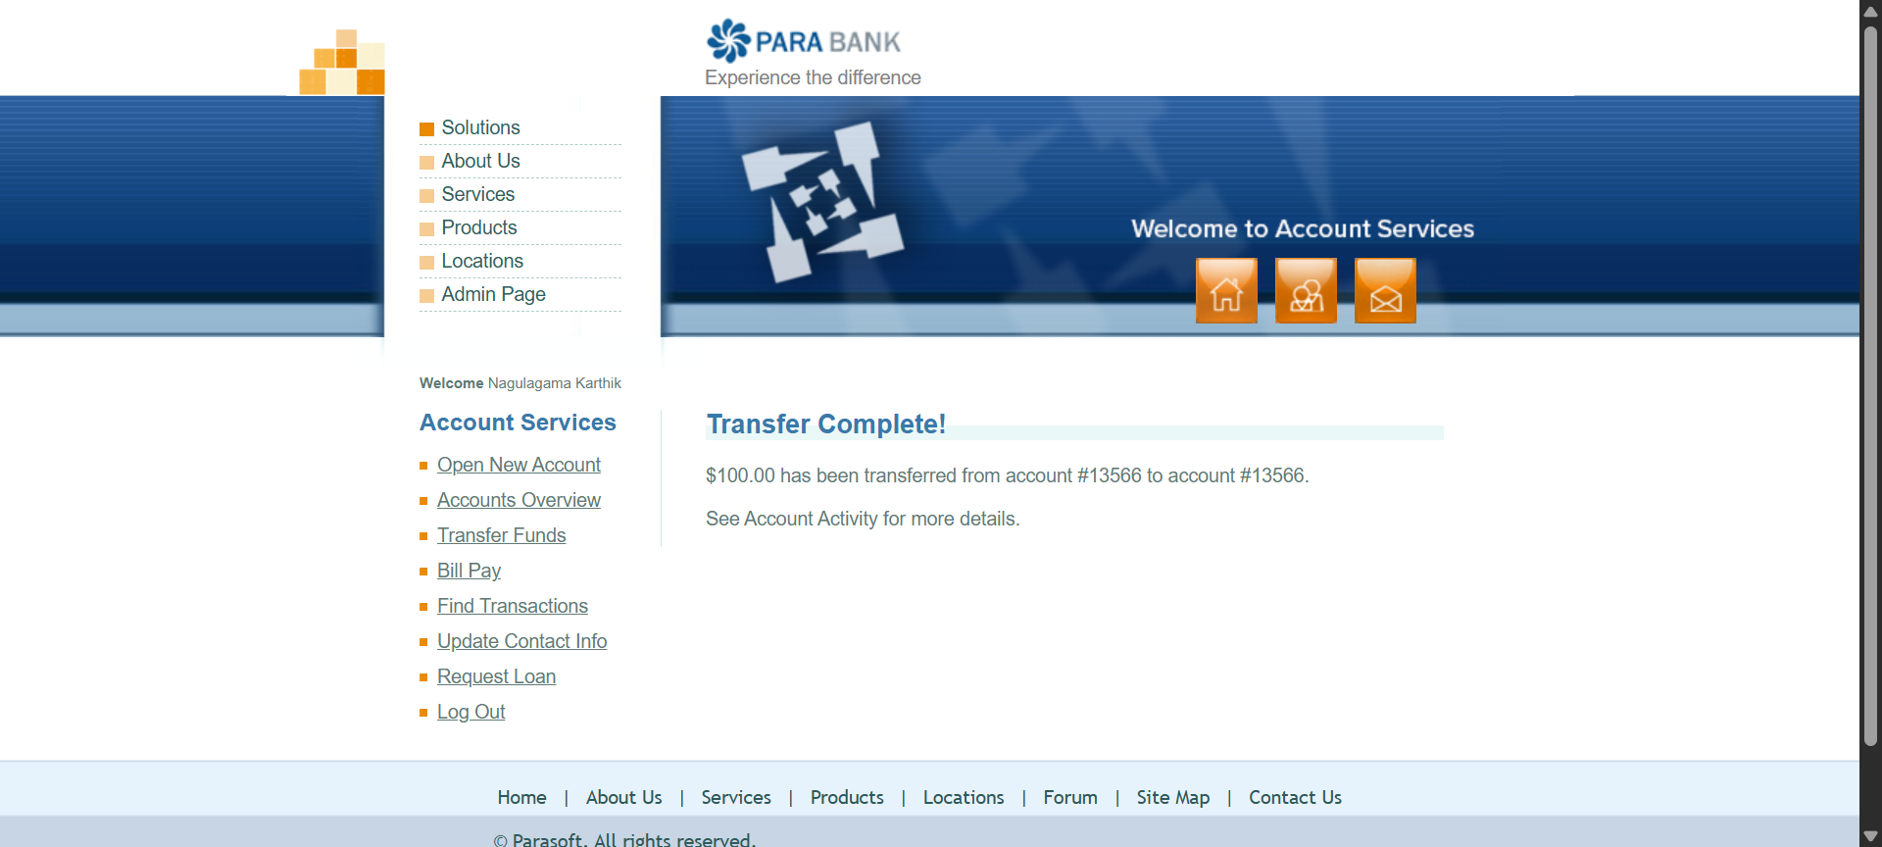
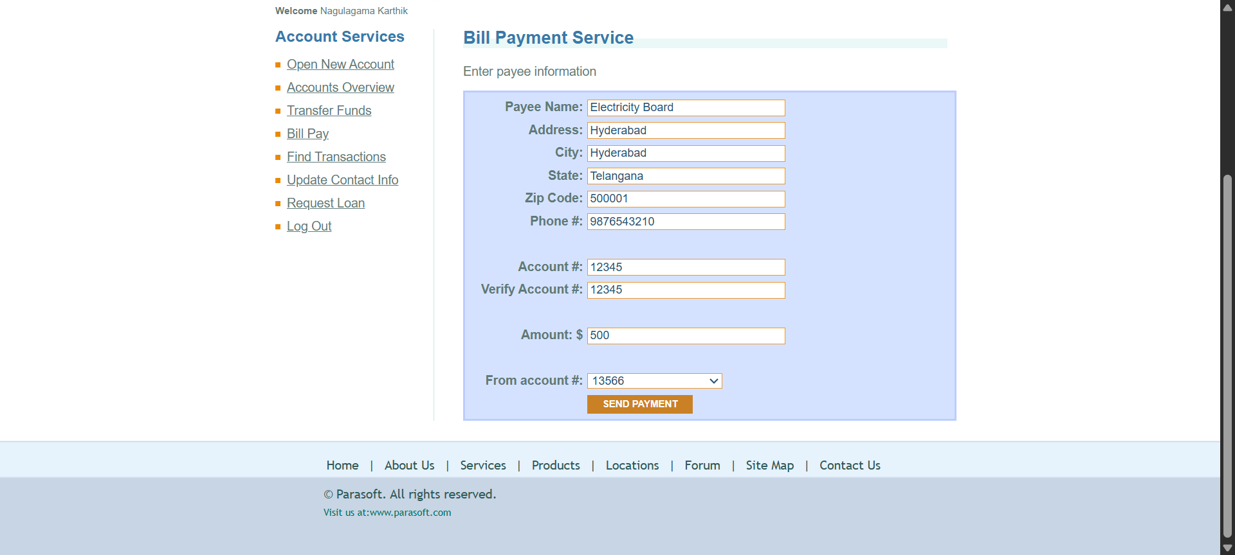
Screenshots Captured – Visual Evidence
📸
📸
📸
✓ PASSED
✓ PASSED
✓ PASSED
RegisterTest_Passed.png
TransferFunds_Passed.png
BillPay_Passed.png
Step 1
Step 2
Step 3
Confirmation showing 'Registration Successful' with the generated username visible
ParaBank page displaying 'Transfer Complete!' with amount and account details
Success screen showing 'Bill Payment Complete' with payee and amount confirmed
Notes:
ScreenshotUtil captures PNG evidence for each test — saved to the Screenshots folder with timestamped filenames.

Slide 23
Console Output – Test Execution Log
[RemoteTestNG] detected TestNG version 7.10.2
Browser Started
Registration Successful
Username : Karthik1781527161032
Login Successful
Browser Started
Username Used = Karthik1781527161032
Current URL = https://parabank.parasoft.com/parabank/overview.htm
Page Title = ParaBank | Accounts Overview
LOGIN SUCCESS
Funds Transfer Successful
Screenshot Saved
Jun 15, 2026 6:09:40 PM org.openqa.selenium.devtools.CdpVersionFinder findNearestMatch
WARNING: Unable to find CDP implementation matching 149
Jun 15, 2026 6:09:40 PM org.openqa.selenium.chromium.ChromiumDriver lambda$new$5
WARNING: Unable to find version of CDP to use for 149.0.7827.104. You may need to include a dependency on a specific version of the CDP using something similar to `org.seleniumhq.selenium:selenium-devtools-v86:4.21.0` where the version ("v86") matches the version of the chromium-based browser you're using and the version number of the artifact is the same as Selenium’s.
Browser Started
Current URL = https://parabank.parasoft.com/parabank/overview.htm
Page Title = ParaBank | Accounts Overview
Bill Payment Completed
Screenshot Saved
TestNG Working
===============================================
ParaBankSuite
Total tests run: 4, Passes: 4, Failures: 0, Skips: 0
===============================================
Notes:
The Eclipse console logs every test step. 'BUILD SUCCESS' at the end confirms all 4 tests passed.

Slide 24
Test Results – 100% Pass Rate
4
4
0
Total Tests
Passed
Failed
0
Execution Summary
► Duration: ~33 seconds for the full test suite
Skipped
► Browser: Google Chrome via ChromeDriver
► Environment: Local machine execution
► Evidence: Screenshots saved for all 4 tests
Notes:
All 4 tests passed — 100% pass rate. Full suite ran in ~38 seconds.

Slide 25
Conclusion
Key Achievements of the ParaBank Automation Framework
Successfully designed and implemented a Selenium + Java automation framework from scratch
✓ Done
Built a complete framework — no shortcuts
Applied Page Object Model pattern across all 4 page classes for clean, reusable code
✓ Done
Industry-standard design pattern applied
Executed all 4 test cases with 100% pass rate and zero failures
✓ Done
Verified end-to-end banking workflows
Captured automated screenshots as visual evidence for each test
✓ Done
Professional test evidence management
Achieved full automation of Register → Login → Transfer → BillPay flow
✓ Done
Complete banking workflow automated
Thank You
Nagulagama Karthik | SDET Automation Project
Notes:
Summary: full framework built, POM applied, 100% pass rate, screenshots captured, and complete banking flow automated. Thank you!

